Slide 1
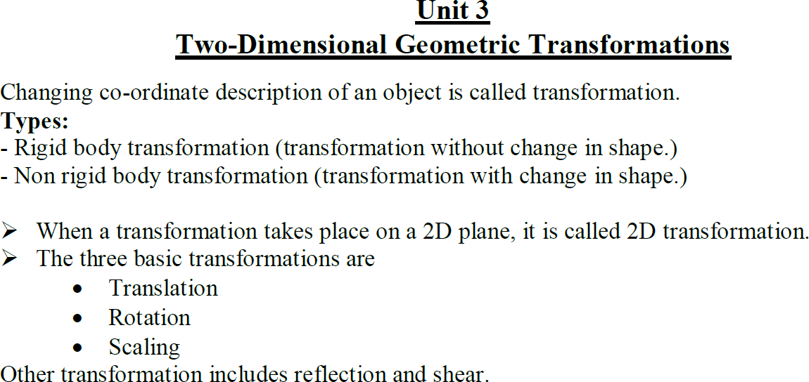

Slide 2
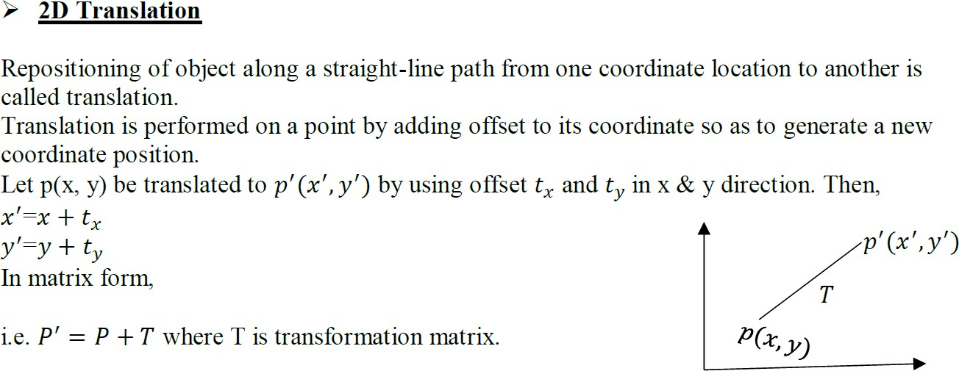

Slide 3
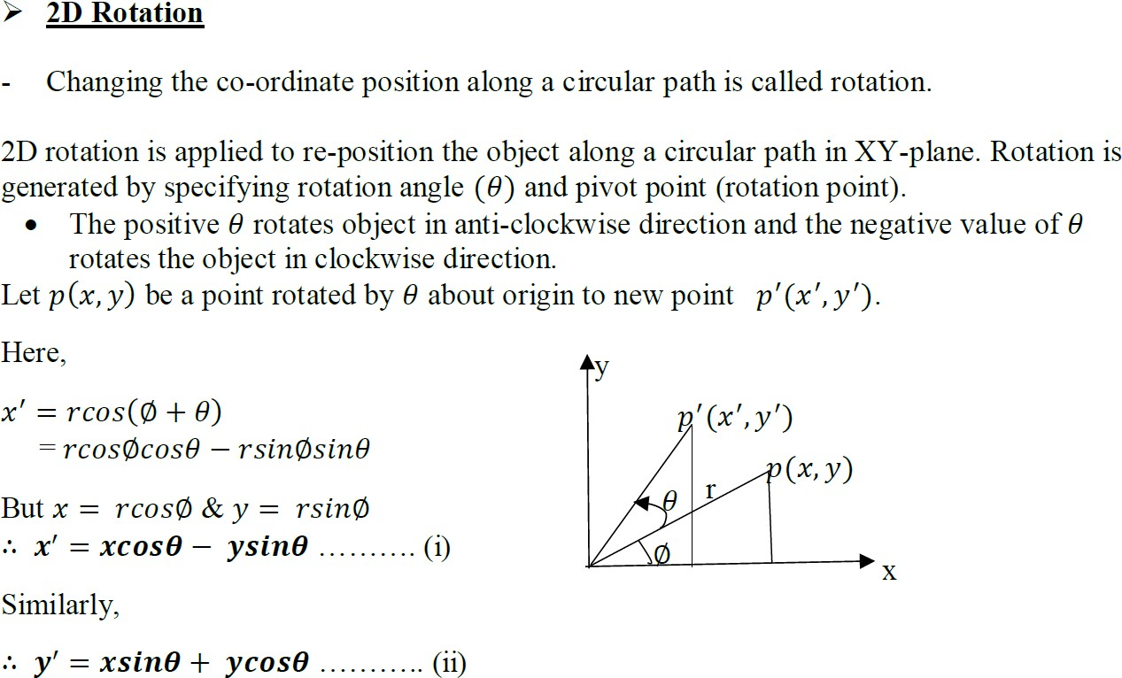

Slide 4
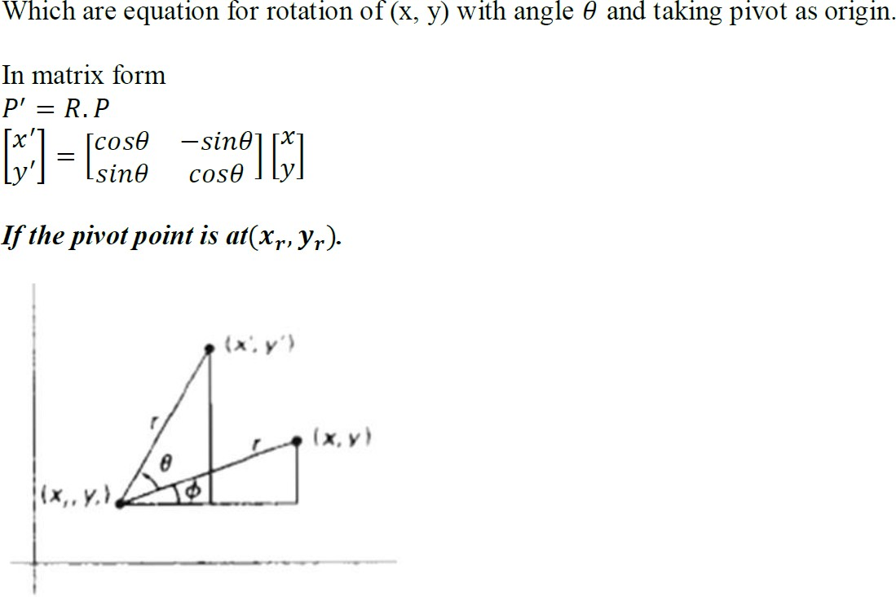
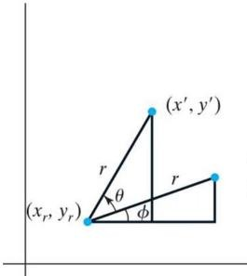
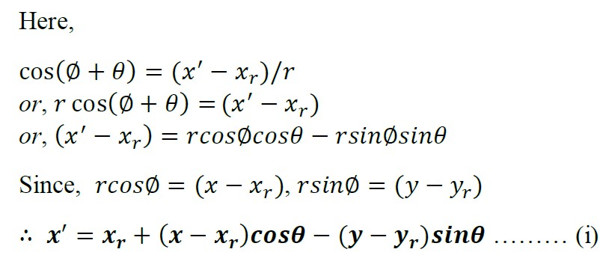

Slide 5
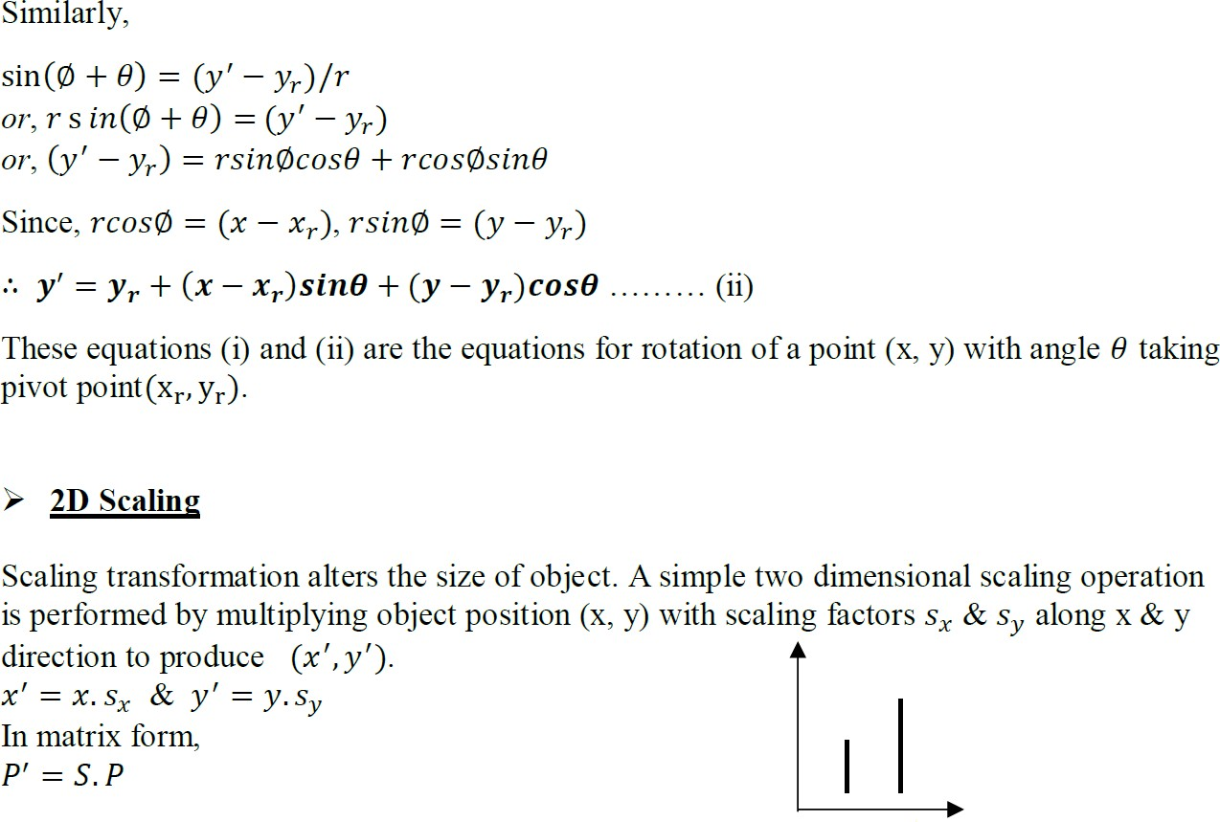

Slide 6
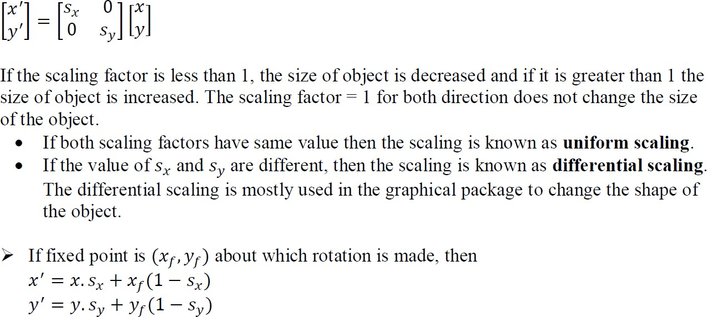

Slide 7
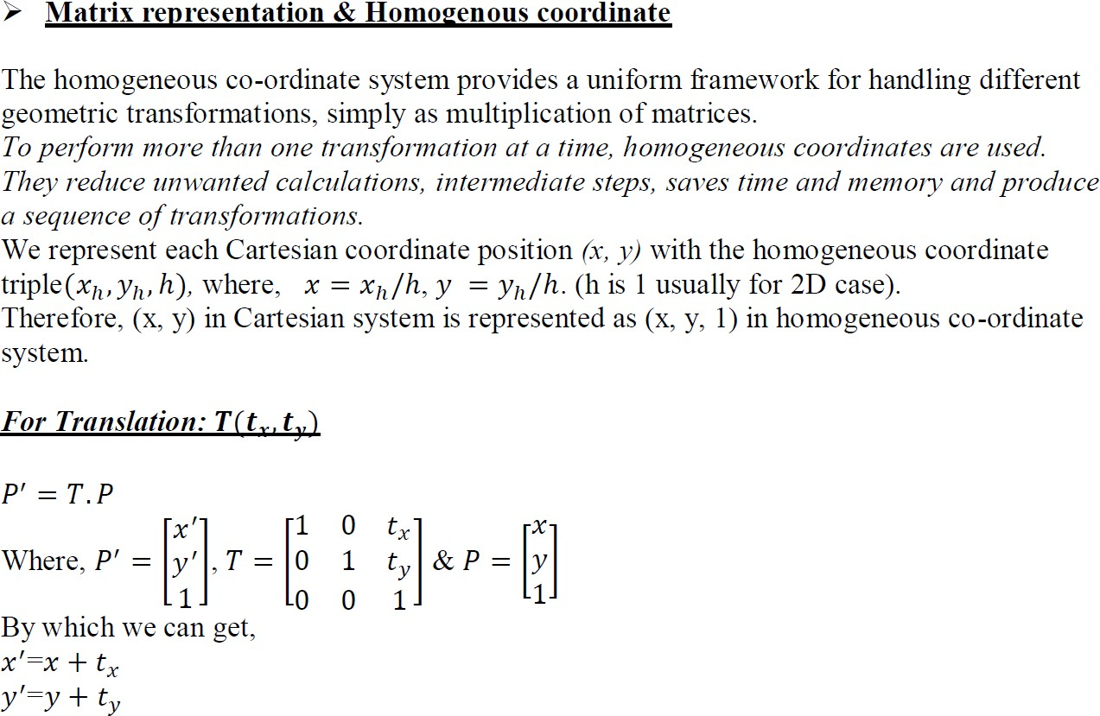

Slide 8
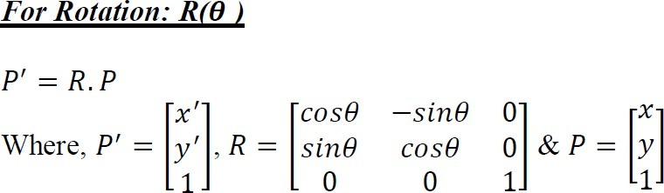

Slide 9
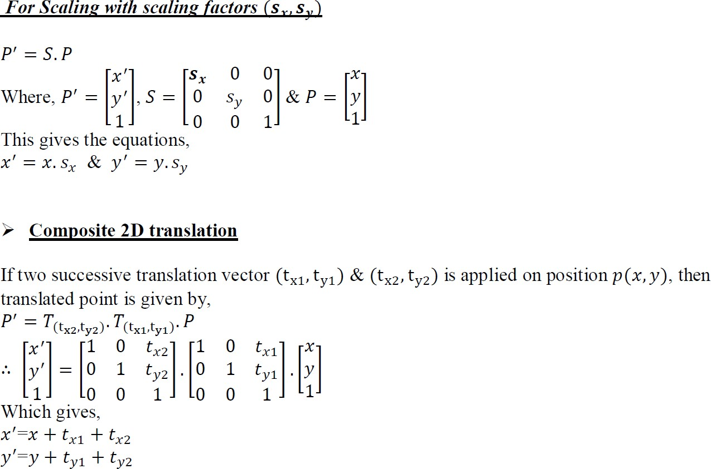

Slide 10
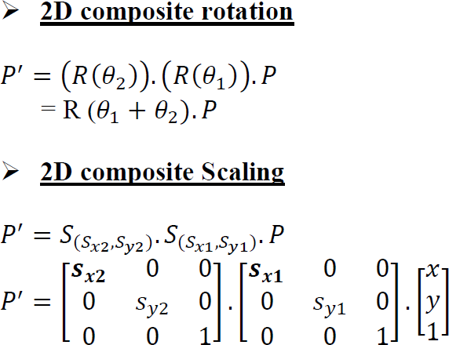

Slide 11
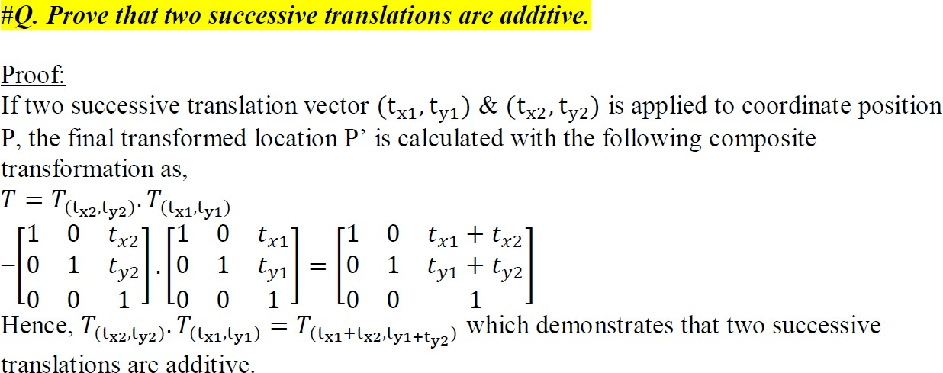

Q. Prove that two successive translations are additive.

Slide 12
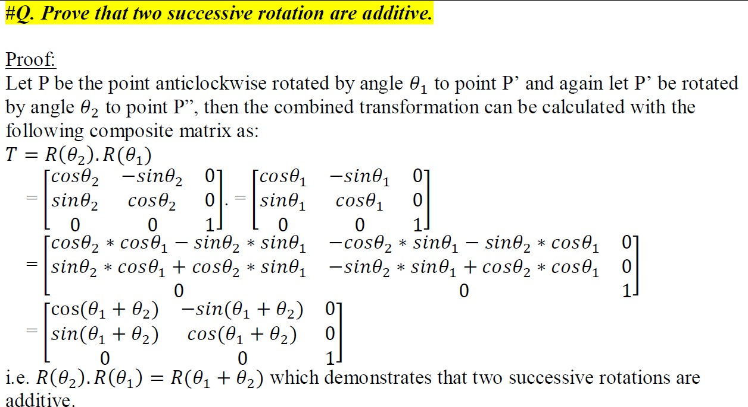

Q. Prove that two successive rotation are additive

Slide 13

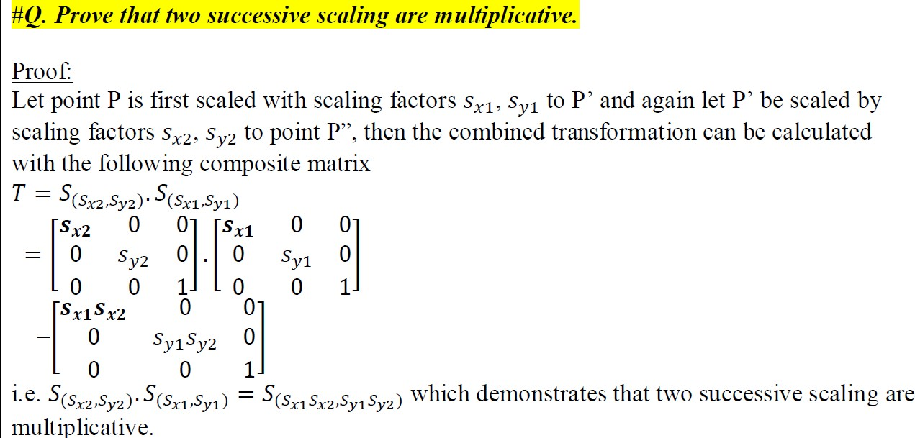
Q. Prove that two successive scaling are multiplicative.

Slide 14
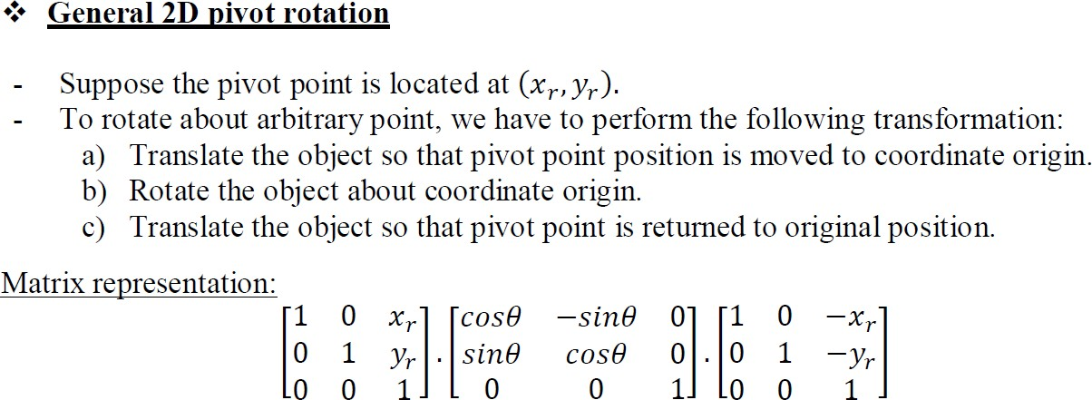
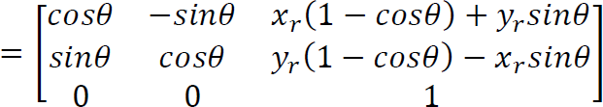

Slide 15
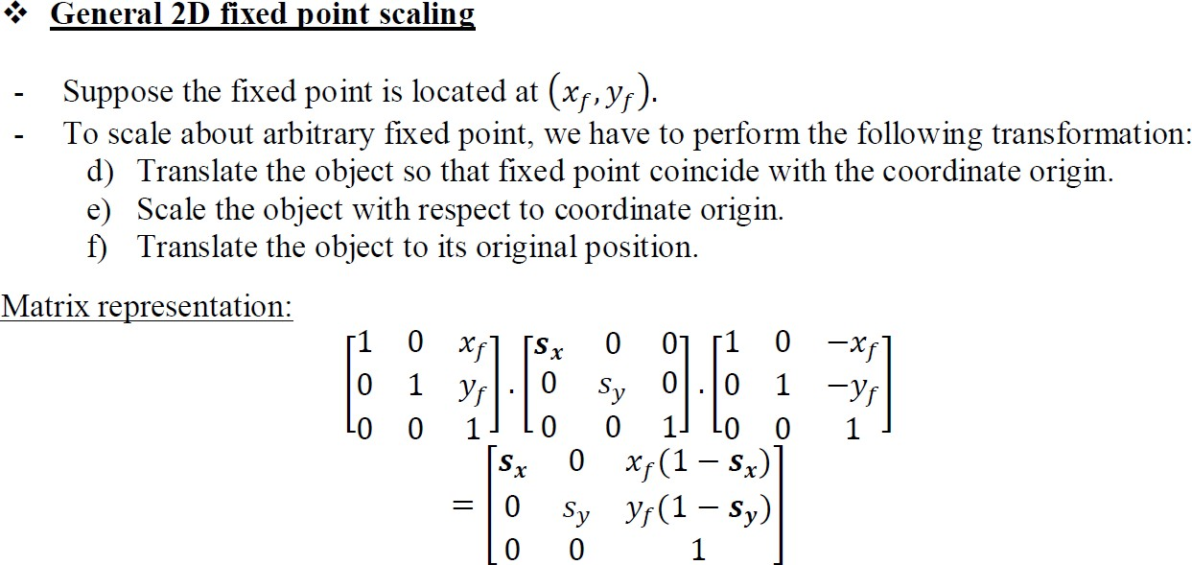

Slide 16
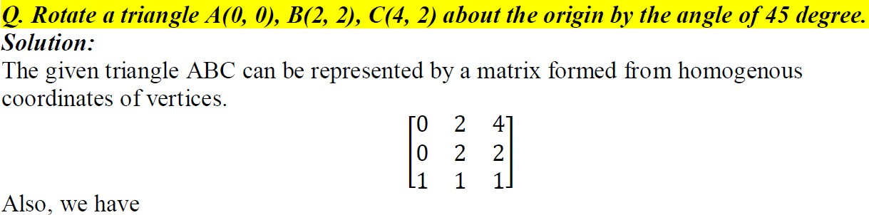
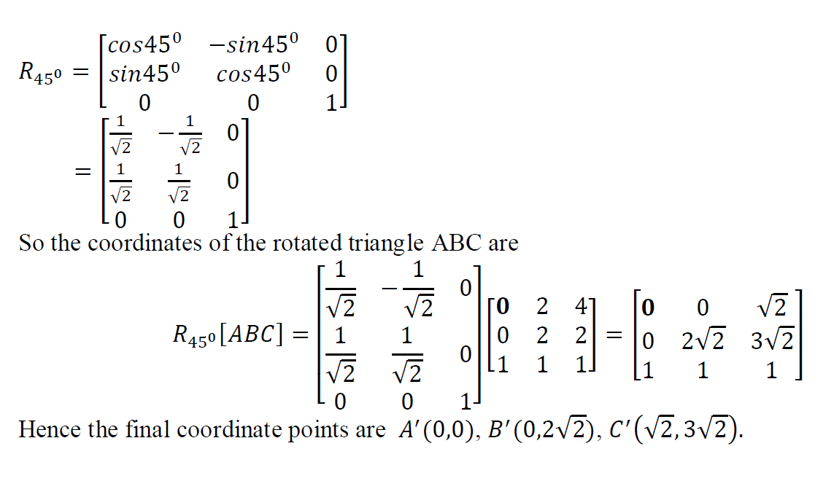
Q. Rotate a triangle A(0, 0), B(2, 2), C(4, 2) about the origin by the angle of 45 degree.

Slide 17
Q. Find the scaled triangle with vertices A(0, 0), B(1, 1) & C(5, 2) after it has been magnified twice its size. Ans: A’(0,0) B’(2,2) C’(10,4)

Slide 18
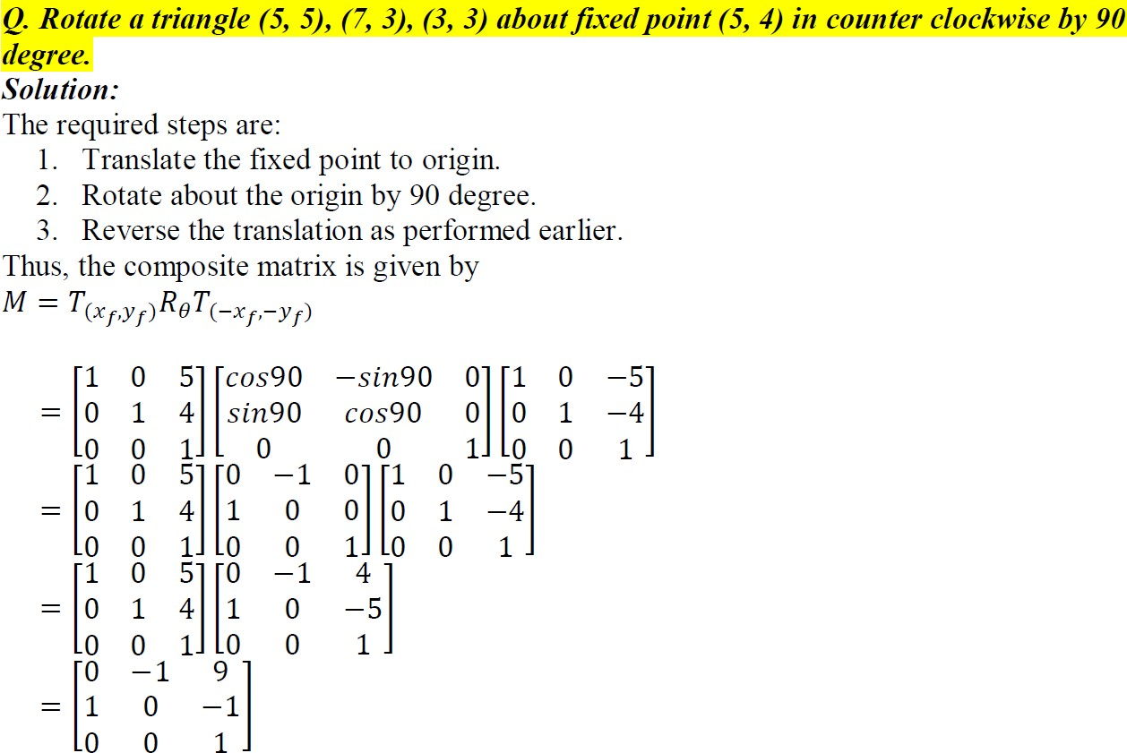
Q. Rotate a triangle (5, 5), (7, 3), (3, 3) about fixed point (5, 4) in counter clockwise by 90 degree.

Slide 19
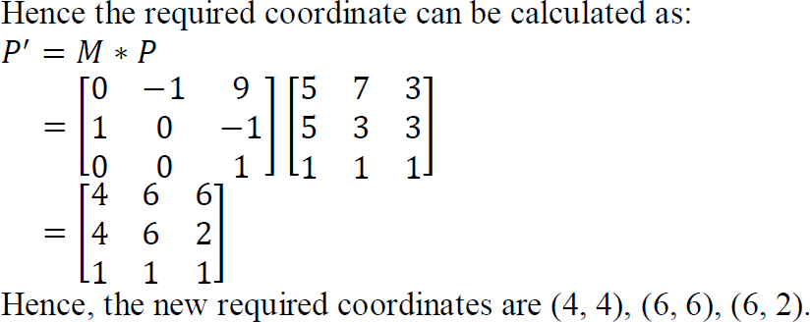

Slide 20
Q. Rotate a triangle A(7, 15), B(5, 8) & C(10, 10) by 45 degree clockwise about origin and
scale it by (2, 3) about origin.

Slide 21
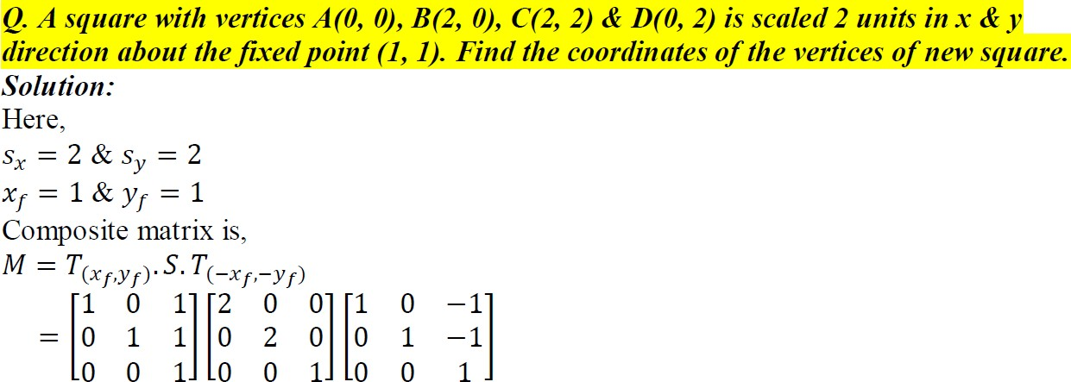
Q. A square with vertices A(0, 0), B(2, 0), C(2, 2) & D(0, 2) is scaled 2 units in x & y direction about the fixed point (1, 1). Find the coordinates of the vertices of new square.

Slide 22
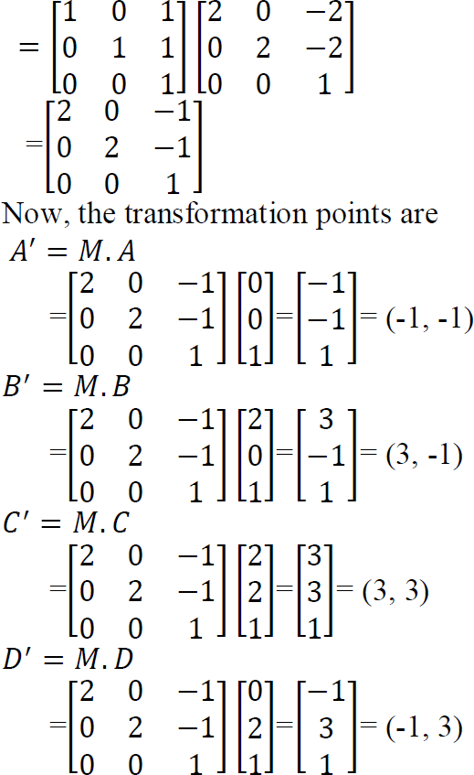
A’=(-1,-1)
B’=(3,-1)
C’=(3,3)
D’=(-1,3)

Slide 23
Q. A triangle having vertices A(3, 3), B(8, 5) & C(5, 8) is first translated by 2 units about fixed point (5, 6) & finally rotated 90 degree anticlockwise about pivot point (2, 5). Find the final position of triangle.

Slide 24
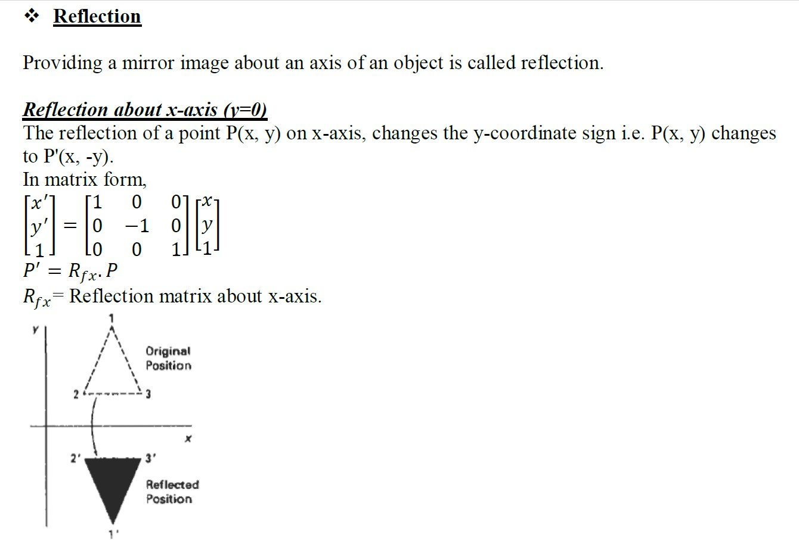

Slide 25
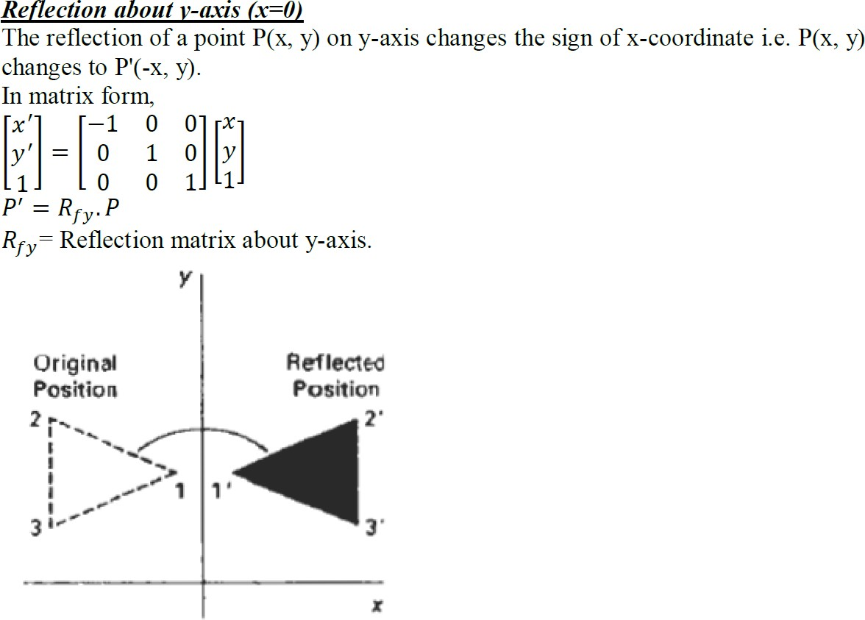

Slide 26
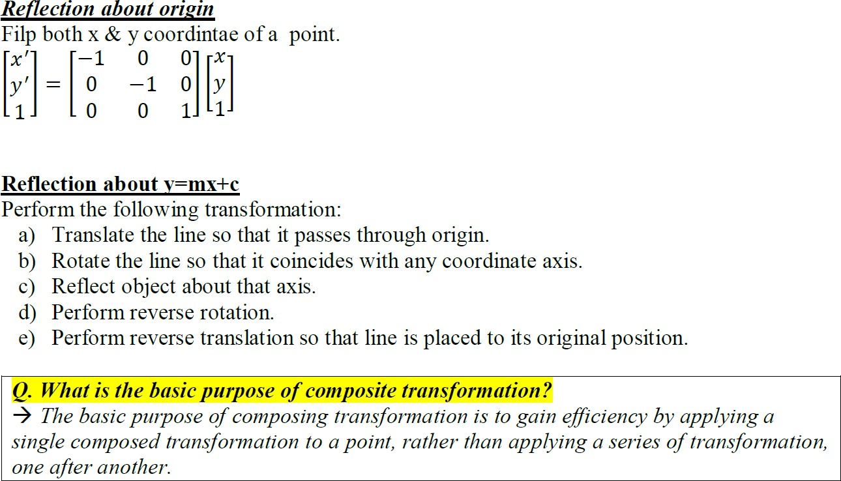

Slide 27

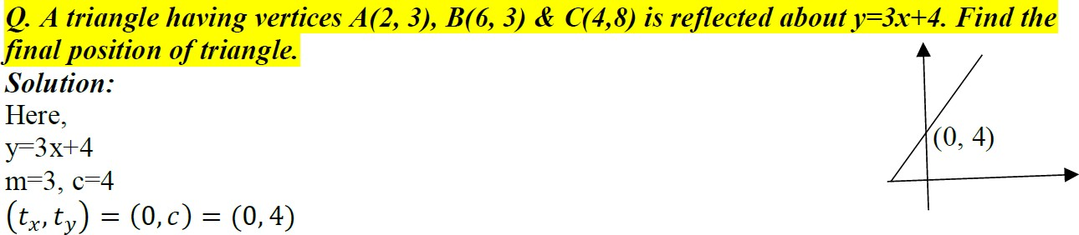
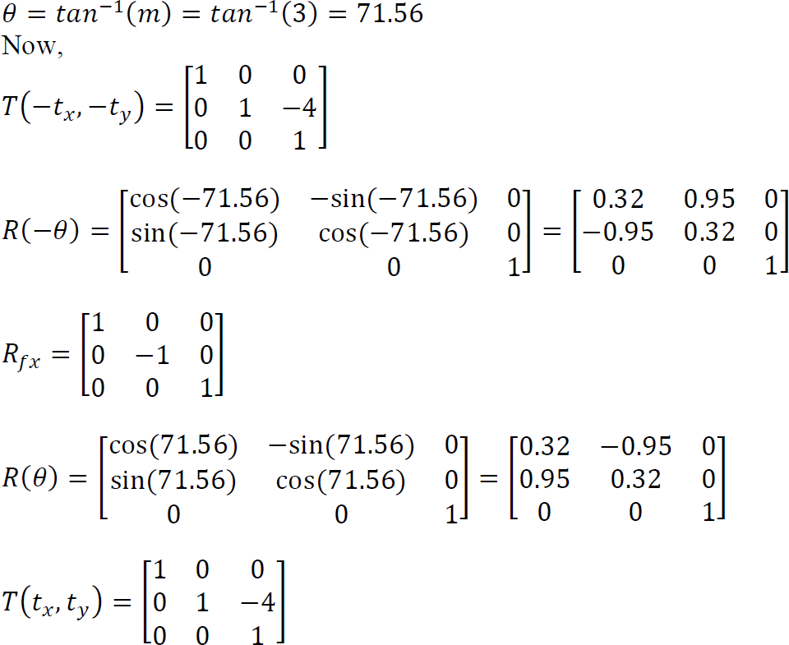
Q. A triangle having vertices A(2, 3), B(6, 3) & C(4,8) is reflected about y=3x+4. Find the final position of triangle.

Slide 28
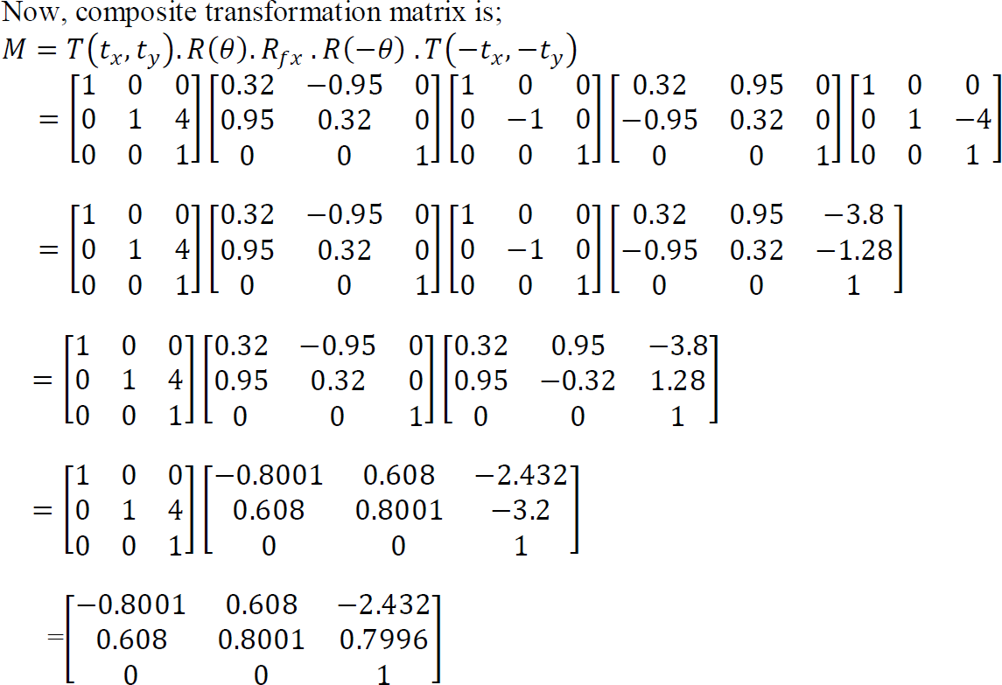

Slide 29
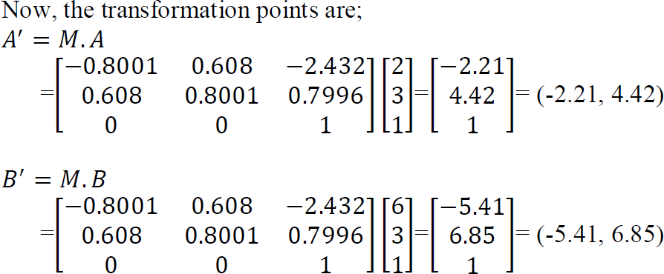
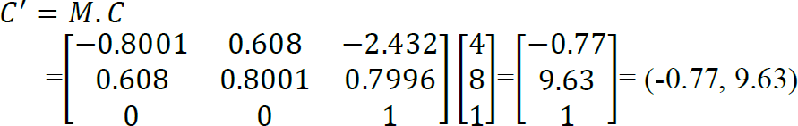

Slide 30
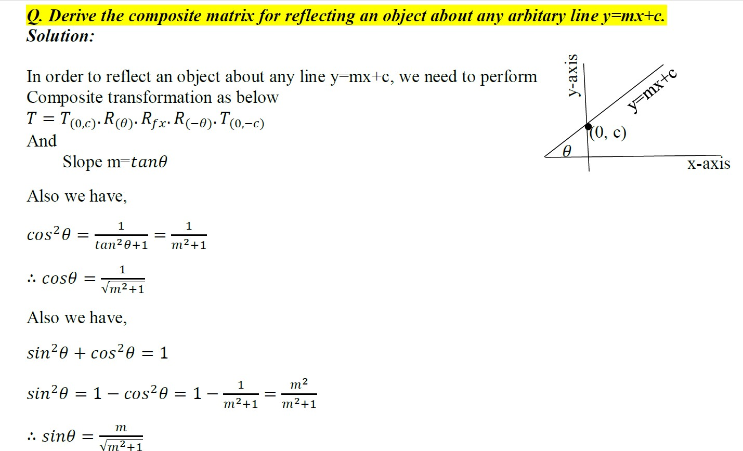
Q. Derive the composite matrix for reflecting an object about any arbitary line y=mx+c.

Slide 31
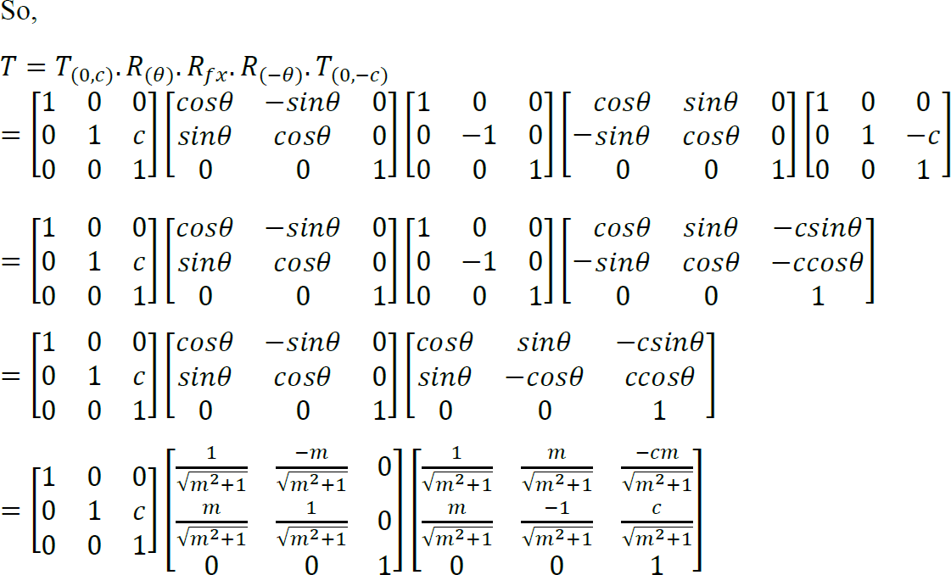

Slide 32
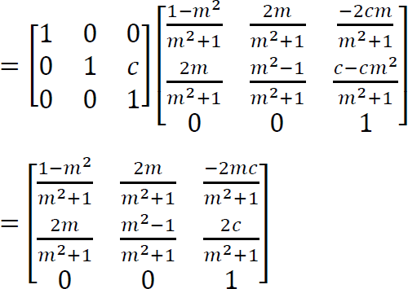

Slide 33
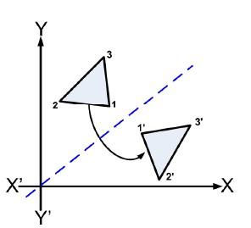
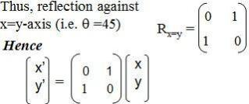
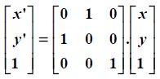
(iv) Reflection about line y = x
x’ = y y’ = x
Equivalent to:
In Homogeneous co-ordinate form
Reflection about x-axis
Rotate anticlockwise 90˚
OR
Clockwise rotation 45 ˚
Reflection with x-axis
anticlockwise rotation 45 ˚
18

Slide 34
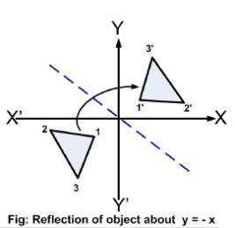
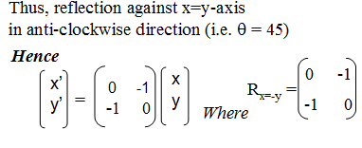
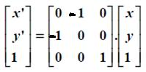
(v) Reflection about line y = -x
x’ = -y
y’ = -x
In Homogeneous co-ordinate form
Equivalent to:
Reflection about y-axis
Rotate anticlockwise 90˚
OR
Clockwise rotation 45 ˚
Reflection with y-axis
anticlockwise rotation 45 ˚

Slide 35
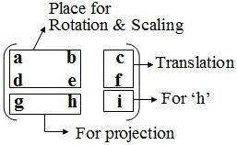
The matrix representations for translation, scaling and rotation
are respectively:
Translation: P’ = T + P (Addition)
Scaling: P’ = S . P (Multiplication)
Rotation: P’ = R . P (Multiplication)
53
Here, in case of homogenous coordinates we add a third coordinate ‘h’ to a point (x, y) so that each point is represented by (hx, hy, h). The ‘h’ is normally set to 1. If the value of ‘h’ is more the one value then all the co-ordinate values are scaled by this value.

Slide 36
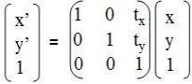
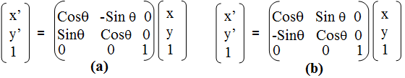
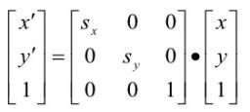
Homogenous Coordinates
For translation
With T( tx , ty ) as translation matrix, inverse of this translation matrix is
obtained by representing tx, ty with -tx, -ty
For rotation
Here, figure-a shows the Counter Clockwise (CCW) rotation & figure-b shows the Clockwise (CW) rotation.
For scaling
Inverse Scaling:1/sx and 1/sy

Slide 37
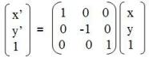
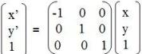
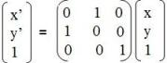
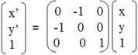
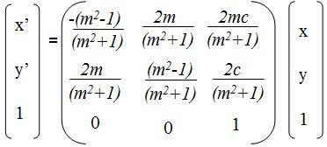
For Reflection
Reflection about x-axis
Reflection about y-axis
Reflection about y=x
Reflection about y=-x
Reflection about any line y=mx+c

Slide 38

2.Shear
It distorts the shape of object in either ‘x’ or ‘y’ or both direction. In case of single directional shearing (e.g. in ‘x’ direction can be viewed as an object made up of very thin layer and slide over each other with the base remaining where it is). Shearing is a non-rigid-body transformation that moves objects with deformation.

Slide 39


Slide 40


Slide 41


Slide 42


x-direction Shear
y-direction Shear

Slide 43
X-direction shear relative to other reference line
(1,1)
(2,1)
(0,1)
(1,1)
sh_{x}=1/2
(0,0)
Yref =-1
(1/2,0)
(3/2,0)
(1,0)
Yref =-1
We can generate x-direction shears relative to other referance lines with
1 shx -sh_{x} *yref
With coordinate positions transformed as
x’= x + sh_{x} (y - yref)
y’ = y
0 1 0
0 0 1

Slide 44
Composite Transformation
With the matrix representation of transformation equations it is possible to setup a matrix for any sequence of transformations as a composite transformation matrix by calculating the matrix product of individual transformation. Forming products of transformation matrices is often referred to as a concatenation, or composition, of matrices. For column matrix representation of coordinate positions we form composite transformation by multiplying matrices in order from right to left.
Right to Left
A.B != B.A

Slide 45

Example 2
Rotate the triangle (5, 5), (7, 3), (3, 3) about fixed point (5, 4) in counter clockwise by 90 degree.
The composite matrix is given by
Cm = T'(xf, yf) . R(ϴ) .T(-xf, -yf)

Slide 46


P’ = Cm . P
Hence, the new vertices of the triangle are
(4, 4), (6, 6) & (6, 2).
68

Slide 47
Practice Questions
1. Find the coordinate of a triangle A(1,3) , B(2,5) and C(3,3)
after twice its original size
about origin
about fixed point (2,3)
Find the coordinate of a triangle A(1,3) , B(2,5) and C(3,3) after being rotated about fixed point P(2,4) by 45⁰ in clockwise direction and then translate by (3,4) .
3.Find the coordinate of a triangle (5, 5), (7, 3), (3, 3) after scaling twice about (2,3) and then reflect by y=0 line.
Cm=ref(x).T’(2,3).S(2,2).T(-2,-3)
P’=Cm.P
4. Find the coordinate of a triangle (5, 5), (7, 3), (3, 3) after translating by (1,0 ) and then reflect by x=0 line.
5.Find the coordinate of a line (5, 5), (3, 3) after rotating by 45⁰ at fixed point (3,3) then translate by (1,1) followed by reflection at x-axis.
75

Slide 48
Exercise
Q.N.1 Reflect an object (2, 3), (4, 3), (4, 5) about line y = x +1.
Solution
82

Slide 49
Here, the required steps are:
Translate the line to origin by decreasing the y-intercept with one.
Rotate the line by angle 45⁰ in clockwise direction so that the given line must overlap x-axis.
Reflect the object about the x-axis.
Reverse rotate the line by angle -45⁰ in counter-clockwise direction.
Reverse translate the line to original position by adding the y-
intercept with one.
Thus, the composite matrix is given by:
^{CM=T’}(0,C) ^{. R’}θ^{. R}refl^{. R}θ ^{. T}(0,-C)
83

Slide 50

Now, the required co-ordinate can be calculated as:
P’ = Cm * P
86
Hence, the final coordinates are (2, 3), (2, 5) & (4, 5).

Slide 51
Exercise
Reflect a triangle A(1,8) B(3,8) and C(1,6) about line y= x+2
87

Slide 52

Exercise
A mirror is placed such that it passes through (0,10),
(10, 0). Find the mirror image of an object (6,7), (7, 6), (6, 9).
Solution
Here,
The given mirror or line is passing through the points (0, 10) & (10, 0).
Now, the slope of the line
(m) = (y2-y1) / (x2-x1)
= (0 - 10) / (10 - 0) = -1
Thus, the rotation angle (θ)
= Tan ⁻¹ (m) = Tan ⁻¹(-1)
= - 45⁰
88
Equation of a mirror line is y=(-1)x+10
i.e. m=-1,c=10

Slide 53
The composite matrix is given by:
^{Cm= T}(10,0) . ^{R (-}_{ᶿ}⁾ ^{.R}fx .^{R (}_{ᶿ}⁾ ^{.T} (-10, 0)
89

Slide 54
-
Cm=

Slide 55

The required new vertices are
P’=cm*P
Hence, the final coordinates are (3, 4), (4, 3) & (1, 4).

Slide 56

Transformation Between 2D-Coordinate System

Slide 57

The Transformation matrix can be obtained as
Where,

Slide 58


Slide 59
Lab 2
Write a program in a high level language to implement 2D Transformation.

Slide 60
/*
/*Example: Program for translation of 2D objects using homogeneous co-ordinates representation of object for its vertices which translates the rectangle by given translation vector.*/
#include<stdio.h>
#include<conio.h>
#include<stdlib.h>
#include<graphics.h>
void matrixmultiply(int T[3][3],int V[3][5],int r[3][5]);
void main()
{
int gdriver, gmode, errorcode;
Int gdriver=DETECT;
initgraph(&gdriver, &gmode, “c:\\turboc3\\bgi");
int i,j,k;
int vertex[3][5]={{100,100,200,200,100},{100,200,200,100,100},
{1,1,1,1,1}};
int translate[3][3] ={{1,0,100},{0,1,200},{0,0,1}};//tx=100,ty=200
int result[3][5];

Slide 61
for(i=0;i<4;i++)
{
setcolor(BLUE);
line(vertex[0][i],vertex[1][i],vertex[0][i+1],vertex[1][i+1]);
}
printf("Press any key for the translated line. \n");
getch();
matrixmultiply(translate,vertex,result);
for(i=0;i<4;i++)
{
setcolor(YELLOW);
line(result[0][i],result[1][i],result[0][i+1],result[1][i+1]);
}
getch();
closegraph();
}

Slide 62
void matrixmultiply(int translate[3][3],int vertex[3][5],int result[3][5])
{
for(int i=0;i<=3;i++)
{
for(int j=0;j<=5;j++)
{
result[i][j]=0;
for(int k=0;k<=3;k++)
result[i][j]+=translate[i][k]*vertex[k][j];
}
}
}

Slide 63
Clipping
63

Slide 64
Two Dimensional Viewing
Two-dimensional viewing is the mechanism for displaying views of a picture on an output device. Much like what we see in real life through a small window on the wall or the viewfinder of a camera, a computer-generated image often depicts a partial view of a large scene. For a 2-D picture, a view is selected by specifying a subarea of the total picture area.
64

Slide 65

Window and Viewport
Window:
A world-coordinate area selected for display is called a window or clipping window. That is, window is the section of the 2D scene that is selected for viewing.
The window defines what is to be viewed.
Viewport
An area on a display device to which a window is mapped is called a viewport.
The viewport indicates where on an output device selected part will be displayed.
65

Slide 66


Slide 67


Slide 68


Slide 69


Slide 70


Slide 71


Slide 72


Slide 73

Q. Window port is given by (100, 100, 300, 300) and viewport is given by (50, 50, 150, 150).
Convert the window port coordinate (200, 200) to the view port coordinate.

Slide 74


Slide 75


Q. Find the normalization transformation matrix for window to viewport which uses the
rectangle whose lower left corner is at (2, 2) and upper right corner is at (6, 10) as a
window and the viewport that has lower left corner at (0, 0) and upper right corner at (1,1)

Slide 76

Q. A world coordinate & viewport have the following geometry: Window (left, right, bottom, top) = (200, 600, 100, 400) Viewport (left, bottom, width, height) = (0, 0, 800, 600). The following vertices are drawn in the world:- P1: (356, 125), P2: (200, 354), P3: (230, 400), P4: (564, 200). What coordinate will each occupy in viewport.

Slide 77

/

Slide 78
Window and viewport are often rectangular in standard positions, because it simplifies the transformation process and clipping process. Other shapes such as polygons, circles take longer time to process.
By changing the position of the viewport, we can view objects at different positions on the display area of an output device. Also by varying the size of viewports, we can change size of displayed objects. Zooming effects can be obtained by successively mapping different-sized windows on a fixed-sized viewport.

Slide 79

Two-Dimensional Viewing Pipeline
The mapping of a part of a world co-ordinate scene to a device co-
ordinate is referred to as viewing transformation.
Sometimes, the 2D viewing transformation is simply referred to as the window–to–viewport transformation or the windowing transformation.
The transformation that maps the window into the viewport is applied to all of the output primitives (lines, rectangles, circles) in world coordinates.
This viewing transformation involves several steps.
14

Slide 80
Viewing transformation in several steps:
First, we construct the scene in world coordinate using the output primitives and attribute. Next to obtain a particular orientation for the window, we can set up a 2-D viewing coordinate system in the window coordinate plane and define a window in viewing coordinates system.
Once the viewing frame is established, we can transform descriptions in world coordinates to viewing coordinates.
We then define a viewport in normalized coordinates (range from 0 to 1) and map the viewing coordinates description of the scene to normalized coordinates.
At the final step, all parts of the picture that lie outside the viewport are dipped, and the contents of the viewports are transferred to device coordinates.

Slide 81

3D –Viewing Pipeline
Modeling coordinates (MC)
World coordinates (WC)
Viewing coordinates (VC)
Projection coordinates (PC)
Normalized coordinates (NC)
Device coordinates (DC)
Fig1: General 3D transformation pipeline, from modeling coordinates to final device coordinates
Figure 1 shows the general processing steps for modeling and converting a world-coordinate description of a scene to device coordinates. Once the scene has been modeled, world-coordinate positions are converted to viewing coordinates. The viewing-coordinate system is used in graphics packages as a reference for specifying the observer viewing position and the position of the projection plane, which we can think of in analogy with the camera film plane. Next, projection operations are performed to convert the viewing-coordinate description of the scene to coordinate positions on the projection plane, which will then be mapped to the output device. Objects outside the specified viewing limits are clipped from further consideration, and the remaining objects are processed through visible-surface identification and surface-rendering procedures to produce the display within the device viewport.

Slide 82

Clipping
The process of identifying those portions of a picture that are either inside or outside of the specified region of space is called clipping.
Before Clipping
After Clipping
Why Clipping?
Excludes unwanted graphics from the screen.
Improves efficiency, as the computation dedicated to
objects that appear off screen can be significantly reduced.
Applications:
In drawing and painting, it is used to select picture parts for copying, erasing, moving.
Identifying visible surfaces in three dimensional views.

Slide 83


Slide 84
Clipping
Point Clipping
Line Clipping
Polygon Clipping

Slide 85



Point Clipping
A point P(x,y) saved
A point P(x,y) clipped

Slide 86


Slide 87

Line Clipping
Lines that do not intersect the clipping window are either completely inside the window or completely outside the window. On the other hand, a line that intersects the clipping window is divided by the intersection point(s) into segments that are either inside or outside the window.

Slide 88


For any particular line segment
Both endpoints are inside the region (line AB):No clipping necessary.
One endpoint is inside and one is outside of the clipping window
(line CD):Clip at intersection point.
Both endpoints are outside the region:
No intersection (lines EF, GH) :Discard the line segment.
d. Line intersects the region (line IJ):Clip line at both intersection points.
Before clipping
After Clipping

Slide 89

Line Clipping…

Slide 90

Cohen-Sutherland Line Clipping Algorithm
One of the oldest and most popular line-clipping algorithms. In this method, coordinate system is divided into nine regions. All regions have their associated region codes. Every line endpoint is assigned a four digit binary code (region code or out code). Each bit in the code is set to either a 1(true) or a 0(false). Assign a bit pattern to each region as shown:
B4 | B3 | B2 | B1
Top | Bottom | Right | Left
D
(xw_{max},yw_{max})
C
21
(xw_{min},yw_{min})
A
B

Slide 91

Algorithm
B4 | B3 | B2 | B1
Top | Bottom | Right | Left
Fourth Bit
Ywmax
First Bit
Second Bit
Ywmin
22
Xwmin
Third Bit
Xwmax
Step 1 : Establish Region code for all line end point
First bit is 1, if x < Xwmin
Second bit is 1, if x > Xwmax
Third bit is 1, if y < Ywmin
Fourth bit is 1, if y > Ywmax
(Point lies to left of window) , else set it to 0 (Point lies to right of window) , else set it to 0 (Point lies to below window), else set it to 0 (Point lies to above window) , else set it to 0

Slide 92


Step 2: Determine which lines are completely inside /outside the window by using following tests:
If both end points of the line has region codes ‘0000’ line is completely inside window.
If logical AND operation of region codes of two end points is NOT ‘0000’, the line is completely outside (some bit position have 1’s on the result of AND operation)
Astart Aend
0000
0000
C
Completely inside
C
D
1001
0001
AND
D
0001
Completely Outside
23
In both of these cases, clipping is not necessary.

Slide 93
Step 3
If both conditions 2(a) and 2(b) fail, then line is partially visible ,so we need to find the intersection with boundaries of window.
If 1st bit is 1 ,then the line intersects with the Left boundary and hence the intersection point (x, y) is given as
x=xw_{min}, y=y₁+m(x-x₁)
b. If ^{2nd} bit is 1 ,then the line intersects with the Right boundary and hence the intersection point (x, y) is given as
x=xw_{max}, y=y₁+m(x-x₁)
c. If 3rd bit is 1 ,then the line intersects with the Bottom boundary and hence the intersection point (x, y) is given as
y=yw_{min}, x=x₁+(1/m)*(y-y₁)
d. If 4th bit is 1 ,then the line intersects with the Top boundary and hence the intersection point (x, y) is given as
y=yw_{max}, x=x₁+(1/m)*(y-y₁)
The process is repeated from step 1 to 3 till all the lines are processed.

Slide 94

Cohen-Sutherland Line Clip Examples

Slide 95






Numerical
Q. Clip a line with end point A(5,30) , B(20,60) against a clip window with
lower most left corner at P₁(10,10) and upper right corner at P₂(100,100)
Ans:
Step 1: Establish the region
codes for end point A,B
P (100,100)
2
A(5,30)
5<10 : (true)= 1
5>100 : (false) =0
30<10 : (false) =0
30>100 : (false) =0
A(5,30) = 0001
B(20,60)
20<10: (false) =0
20>100: (false)=0
60<10 : (false)=0
60>100: (false)=0
B(20,60)=0000
P₁(10,10)
Step 2: Visibility check A: 0001
B: 0000
0000
Partial Visibility
After Clipping
P₂(100,100)
AND
Step 3: Intersection point with boundary for A(5,30):
Region Code:0001 ,
Here, Cond^{n} of 1st bit is 1 so the intersection point is
x= xw_{min}=10
And
y= y₁ + m (x –x₁) = 30 + 2 (10-5)
= 40
So the intersection point(x,y)=(10,40)
27
P₁(10,10)
First bit is 1, if x < Xwmin
Second bit is 1, if x > Xwmax
Third bit is 1, if y < Ywmin
Fourth bit is 1, if y > Ywmax
Top | Bottom | Right | Left
B4 | B3 | B2 | B1

Slide 96
Problem
Q.1. Use Cohen Sutherland line clipping Algorithm to clip a line starting from (-13,5) and ending at (17,11)against a clip window having the lower left corner at (-8,-4) and upper right corner at (12,8).
Q.2.Clip a line with end point A(1,60) , B(20,120) against a clip window with lower most left corner at P1(10,10) and upper right corner at P2(100,100)
Q3.A clipping window is specified as A(0,0),B(40,0),C(40,40),D(0,40).We want to clip two lines P(-20,70) to Q(20,30) and R(50,10) to S(70,70) against this window. Use the outcodes of the end points to find out if the lines are totally invisible or partially visible.

Slide 97
Region code for p1=(0001)
Region code for p2=(1010)
Logical AND gives 0000
For p1 bit 1 is high so the intersection point is (-8,6)
And for p2 both bit 2 and bit 4 is high and intersection points are(12,10) and (2,8) but only (2,8) is accepted.
So the intersection points are (-8,6)and (2,8)

Slide 98
Q1. Given a clipping window P (30,0), S(0,20) use the Cohen Sutherland algorithm to determine the visible portion of the line A(10,30) and B(40,0).
Q2. Clip a line with end point A(1,60) , B(20,120) against a clip window with lower most left corner at P1(10,10) and upper right corner at P2(100,100)
Q3.A clipping window is specified as A(0,0),B(40,0),C(40,40),d(0,40).We want to clip two lines P(-20,70) to Q(20,30) and R(50,10) to S(70,70) against this window. Use the outcodes of the end points to find out if the lines are totally invisible or partially visible.
28

Slide 99


Slide 100


Slide 101

Parameters u₁ and u₂ can be calculated that define the part of line that lies within the clip rectangle. When,
p_{k} < 0, maximum(0, q_{k}/p_{k}) is taken.
p_{k} > 0, minimum(1, q_{k}/p_{k}) is taken.

Slide 102
Q. Apply Liang Barsky Line Clipping algorithm to the line with coordinates (30, 60) and (60, 25) against the window (𝒙𝒘_{𝒎𝒊𝒏}, 𝒚𝒘_{𝒎𝒊𝒏}) = (𝟏𝟎, 𝟏𝟎) and (𝒙𝒘_{𝒎𝒂𝒙}, 𝒚𝒘_{𝒎𝒂𝒙}) = (𝟓𝟎, 𝟓𝟎).
For Numerical: refer class note

Slide 103


Polygon Clipping
To clip a polygon, we cannot directly apply a line-clipping method to the individual polygon edges because this approach would produce a series of unconnected line segments as shown in figure .
The clipped polygons must be a bounded area after clipping as shown in figure. For polygon clipping, we require an algorithm that will generate one or more closed areas that are then scan converted for the area fill. The output of a polygon clipper should be a sequence of vertices that defines the clipped polygon boundaries.
Fg: Concave Polygon

Slide 104
Sutherland Hodgeman Polygon Clipping Algorithm
Clip a polygon by processing the polygon boundary against each window edge. (Left, Top, Bottom, Right).
Apply four cases to process all polygon edges to produce sequence of vertices. This sequence of vertices will make a bounded area.
Beginning with the initial set of polygon vertices, we could first clip the polygon against the left rectangle boundary to produce a new sequence of vertices.
The new set of vertices could be successively passed to a right boundary clipper, a bottom boundary clipper, and a top boundary clipper.

Slide 105

There are four possible cases when processing vertices in sequence around the perimeter of a polygon. As each pair of adjacent polygon vertices is passed to a next window boundary clipper, we make the following tests:
Case 1
If the first vertex is outside the window boundary and the second vertex is inside then , both the intersection point of the polygon edge with the window boundary and the second vertex(which is inside the window boundary) are added to the output vertex list.

Slide 106


Case 2:
If both input vertices are inside the window boundary. Then, only the second vertex is added to the output vertex list.
Case 3:
If the first vertex is inside the window boundary and the second vertex is outside. Then, only the edge intersection with the window boundary is added to the output vertex list.

Slide 107

Case 4:
If both input vertices are outside the window boundary. Then, nothing is added to the output vertex list.

Slide 108


Slide 109

Q. Clip polygon against clipping window PQRS. The coordinates of polygon are A(80, 200), B(220, 120), C(150, 100), D(100, 30), E(10, 120). Coordinates of clipping window P(200, 50), Q(50, 150), R(200, 150) & S(50, 50).

Slide 110


Slide 111



Slide 112


